Slide 1

ADAPTIVE CYCLE
Interactive PowerPoint Template

Slide 2


Home – Do not delete this text – Use for Hyperlink
Passive
REORGANIZATION
CONSERVATION
(K)
(α)
Capital
(r)
(Ω)
EXPLORATION
RELEASE
Active
Connectedness
Weak
Strong

Slide 3



Release – Do not delete this text – Use for Hyperlink
(Ω)
RELEASE
Your Subtitle Here
Working on your projects includes generating bold ideas, picking up suitable color scheme and preparing a bulk of options for your selection.
Working on your projects includes generating bold ideas, picking up suitable color scheme and preparing a bulk of options for your selection.

Slide 4


conservation – Do not delete this text – Use for Hyperlink
(K)
CONSERVATION
Your Subtitle Here
Working on your projects includes generating bold ideas, picking up suitable color scheme and preparing a bulk of options for your selection.
Working on your projects includes generating bold ideas, picking up suitable color scheme and preparing a bulk of options for your selection.

Slide 5


reorganization – Do not delete this text – Use for Hyperlink
(α)
REORGANIZATION
Your Subtitle Here
Working on your projects includes generating bold ideas, picking up suitable color scheme and preparing a bulk of options for your selection.
Working on your projects includes generating bold ideas, picking up suitable color scheme and preparing a bulk of options for your selection.

Slide 6


Growth – Do not delete this text – Use for Hyperlink
(r)
EXPLORATION
Your Subtitle Here
Working on your projects includes generating bold ideas, picking up suitable color scheme and preparing a bulk of options for your selection.
Working on your projects includes generating bold ideas, picking up suitable color scheme and preparing a bulk of options for your selection.

Slide 7
Rigidity Trap 1 – Do not delete this text – Use for Hyperlink
RIDIDITY TRAP
Your Subtitle Here
Working on your projects includes generating bold ideas, picking up suitable color scheme and preparing a bulk of options for your selection.
Working on your projects includes generating bold ideas, picking up suitable color scheme and preparing a bulk of options for your selection.

Slide 8
Rigidity Trap 2 – Do not delete this text – Use for Hyperlink
RIDIDITY TRAP
Your Subtitle Here
Working on your projects includes generating bold ideas, picking up suitable color scheme and preparing a bulk of options for your selection.
Working on your projects includes generating bold ideas, picking up suitable color scheme and preparing a bulk of options for your selection.

Slide 9
Innovation – Do not delete this text – Use for Hyperlink
RAPID INNOVATION
Working on your projects includes generating bold ideas, picking up suitable color scheme and preparing a bulk of options for your selection.
Working on your projects includes generating bold ideas, picking up suitable color scheme and preparing a bulk of options for your selection.
Working on your projects includes generating bold ideas, picking up suitable color scheme and preparing a bulk of options for your selection.

Slide 10


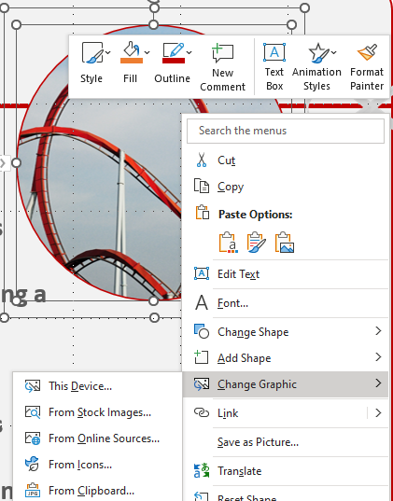
Replacing Pictures in the Template
1. Right click on an image.
2. Choose Change Graphic.
3. Select the new picture from This Device , From Stock Images, From Icons.

Slide 11
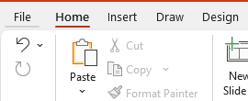
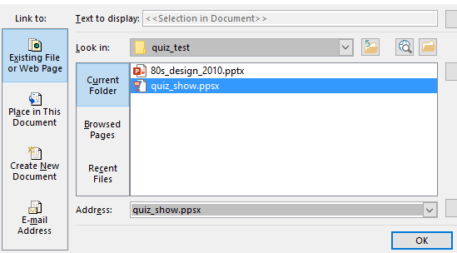
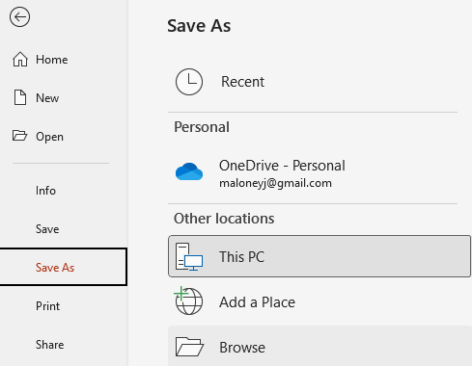
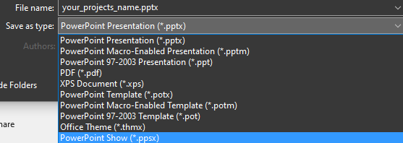
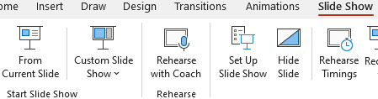
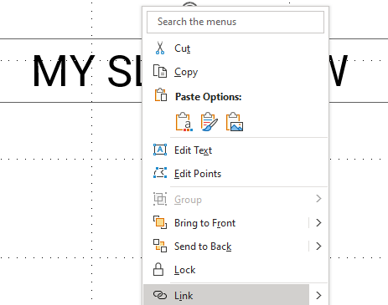
Save As a PowerPoint Show
If you don’t want to include all these slides in your main presentation, but still want to access it from your main presentation, follow these steps.
1. Go to File in the top menu.
2. Choose Save As and click Browse from This PC.
5. Choose Existing File > Current Folder > Choose the .ppsx file you saved from step 3.
3. Click the Save as type: drop down options. Choose PowerPoint Show (.pptx). NOTE* - Save file to your computer in the same folder where your main presentation is saved.
4. Open your main presentation you would like to add the SLIDESHOW in. Make a new Text box on a slide and call it something like “MY SLIDESHOW”.
Right click on the text box and choose Link from the menu.
6. Preview Slide Show and click on the “MY SLIDESHOW” text and the like slideshow should appear. To exit the slideshow hit Esc on your keyboard.
NOTE* You can also use a linked image instead of text. Follow the same steps.

Slide 12
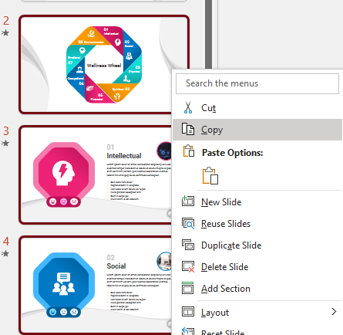
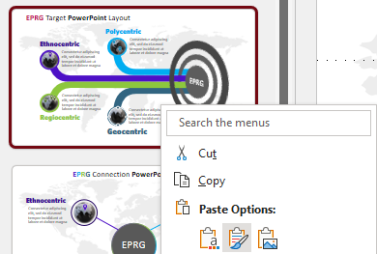
Add Slides to an Existing Presentation
1. Select the slides you would like to copy. You can do this by holding down Shift on your keyboard while clicking multiple slides.
2. Right click on a selected slide and choose Copy.
3. Right click on a slide in the presentation you would like to copy them to.
Choose the middle paste button.

Slide 13
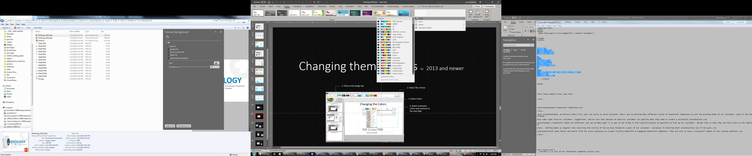
Changing theme Colors in PowerPoint 2013 and newer
4. Select Customize Colors.
1. Click on the design tab
3. Select Colors
2. Select This Arrow

Slide 14
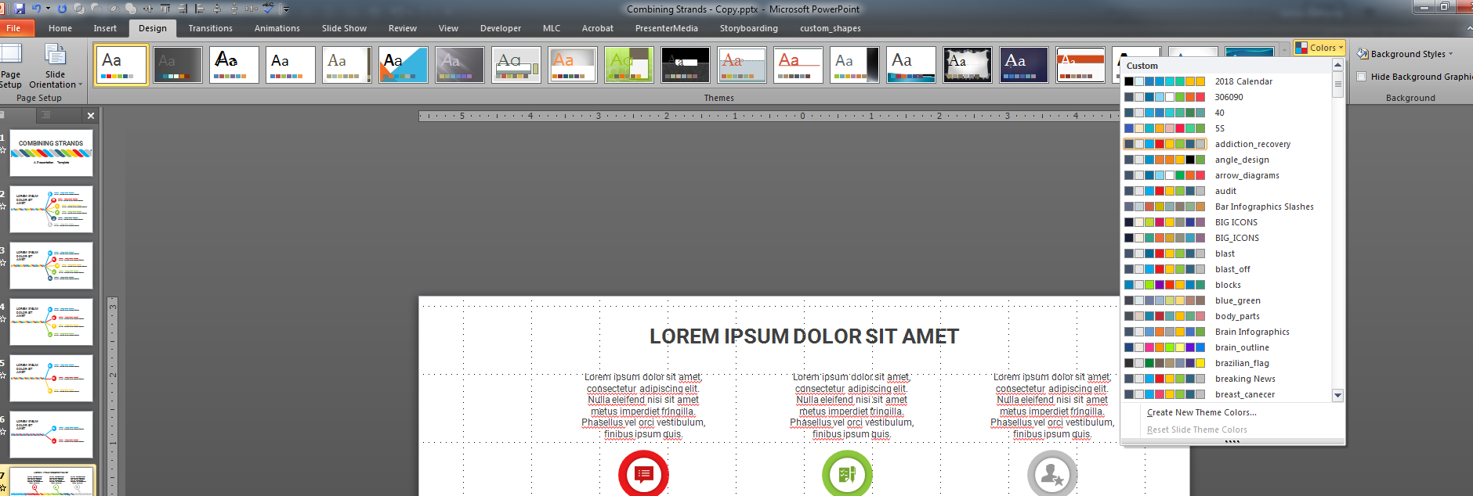
Changing theme Colors in PowerPoint 2010
3. Create New Theme Colors.
2. Select Colors
1. Click on the design tab

Slide 15
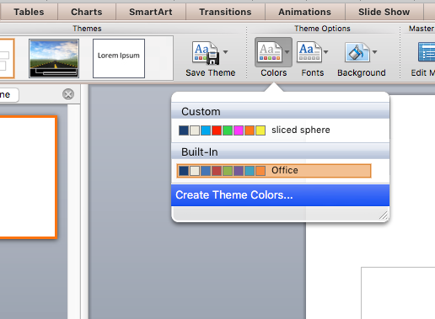
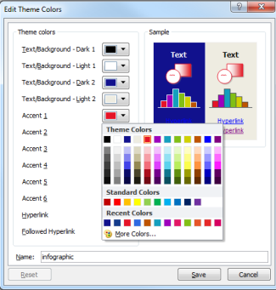
Changing theme Colors in PowerPoint Mac 2011
1. Expand Document Theme
2. Click Create Theme Colors
3. Change Accent Colors

Slide 16
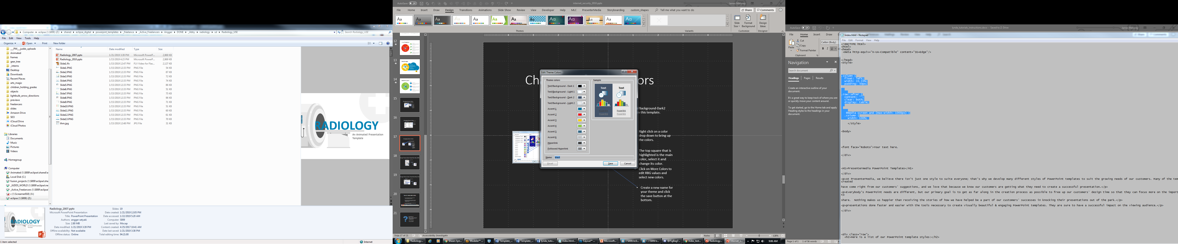
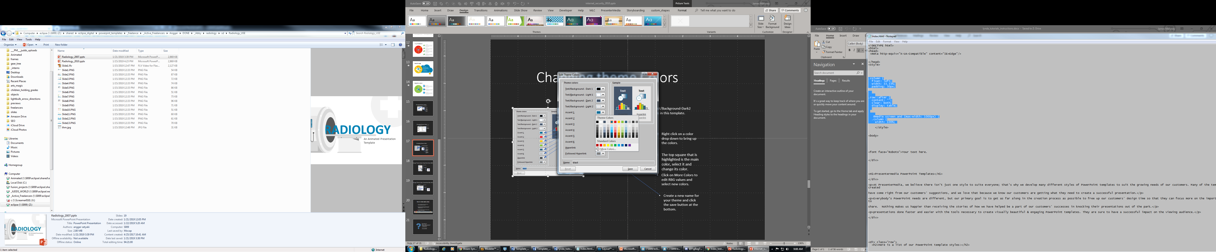
Changing theme ACCENT Colors
All the accents plus the Text/Background-Dark2 are what control the colors in this template.
Left click on a color drop down to bring up the colors.
The top square that is highlighted is the main color, select it and change its color.
Click on More Colors to edit RBG values and select new colors.
Create a new name for your theme and click the save button at the bottom.

Slide 17
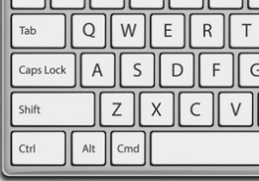
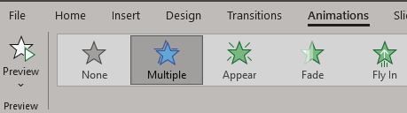
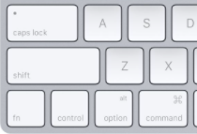
Remove Animation from any slide
1. Go to the slide you would like to remove the animation from.
3. With everything on that slide selected, go to the animation menu and select None.
2. Hold Ctrl and press a on you keyboard to select all.
If on a Mac hold Command and press a.

Slide 18

Questions? More Information?
PresenterMedia.com
support@presentermedia.com
(605) 274-2424

